Slide 1
2024 SURF
Sharing Session
Presenter:
Yu-Hsiang Lo (羅昱翔) from NTUEE B08

Slide 2
Summary
Application tips
SURF’s great benefits
Conclusion

Slide 3
Application tips

Slide 4
My application experience
Search the professors I want to collaborate with on their website.
Prepare my CV and request letter.
Send it to the professors.
Interview.

Slide 5
Tips
You don’t have to come up with a proposal !
Just show that you have solid foundation knowledge and experience.
Send a copy to their assistant.
The request letter should precisely express why you want to collaborate and how you can contribute to them.
Read their publications.
Contact their Ph.D. candidates or post-docs directly.
Respond fast !

Slide 6
SURF’s great benefits
(for your grad school application)

Slide 7
Stronger motivation letter (套詞信)
Some applicants send motivation letters to their potential professors.
Upon enrollment, you will be provided with a Caltech email (XXX@caltech.edu).
Some friends prefer using this for sending motivation letters.

Slide 8
English
There is no better way to practice English than immersing yourself in an English-speaking environment.
Your English will improve without you even realizing it.

Slide 9
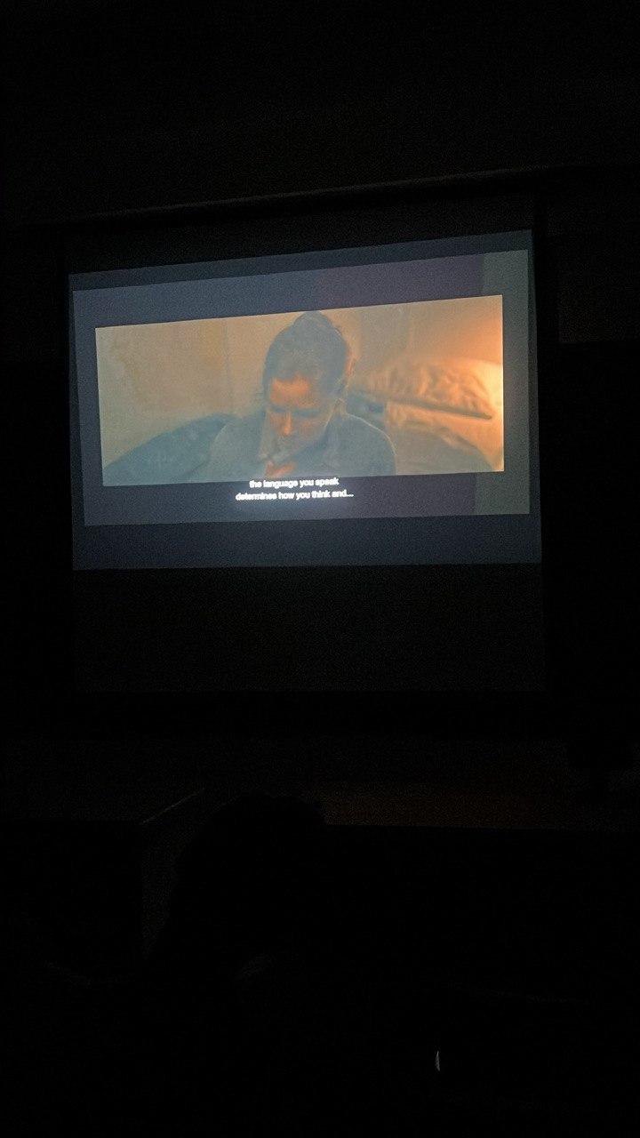
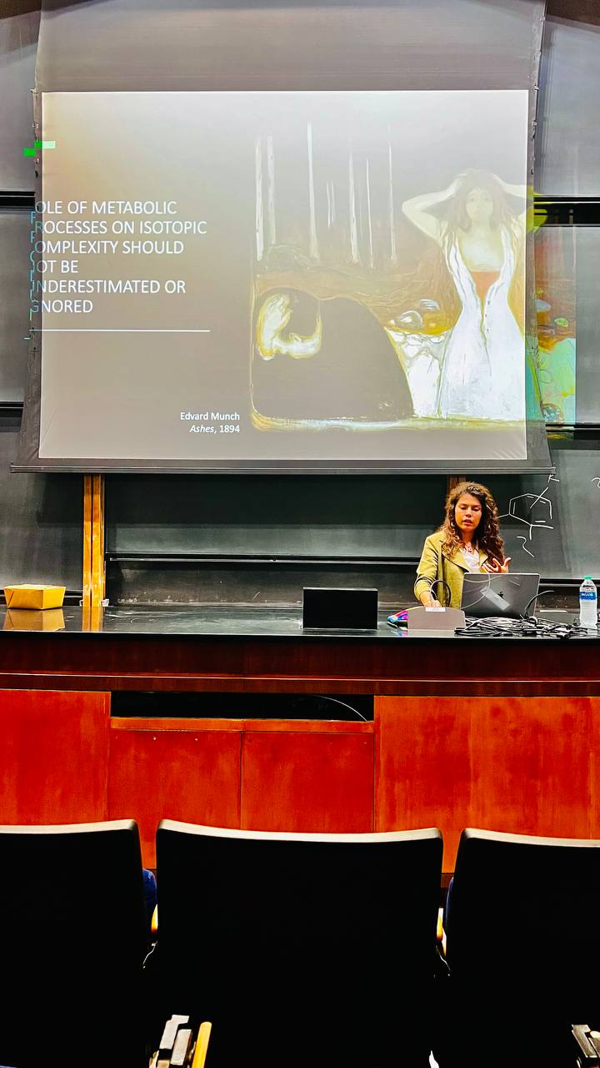

Slide 10
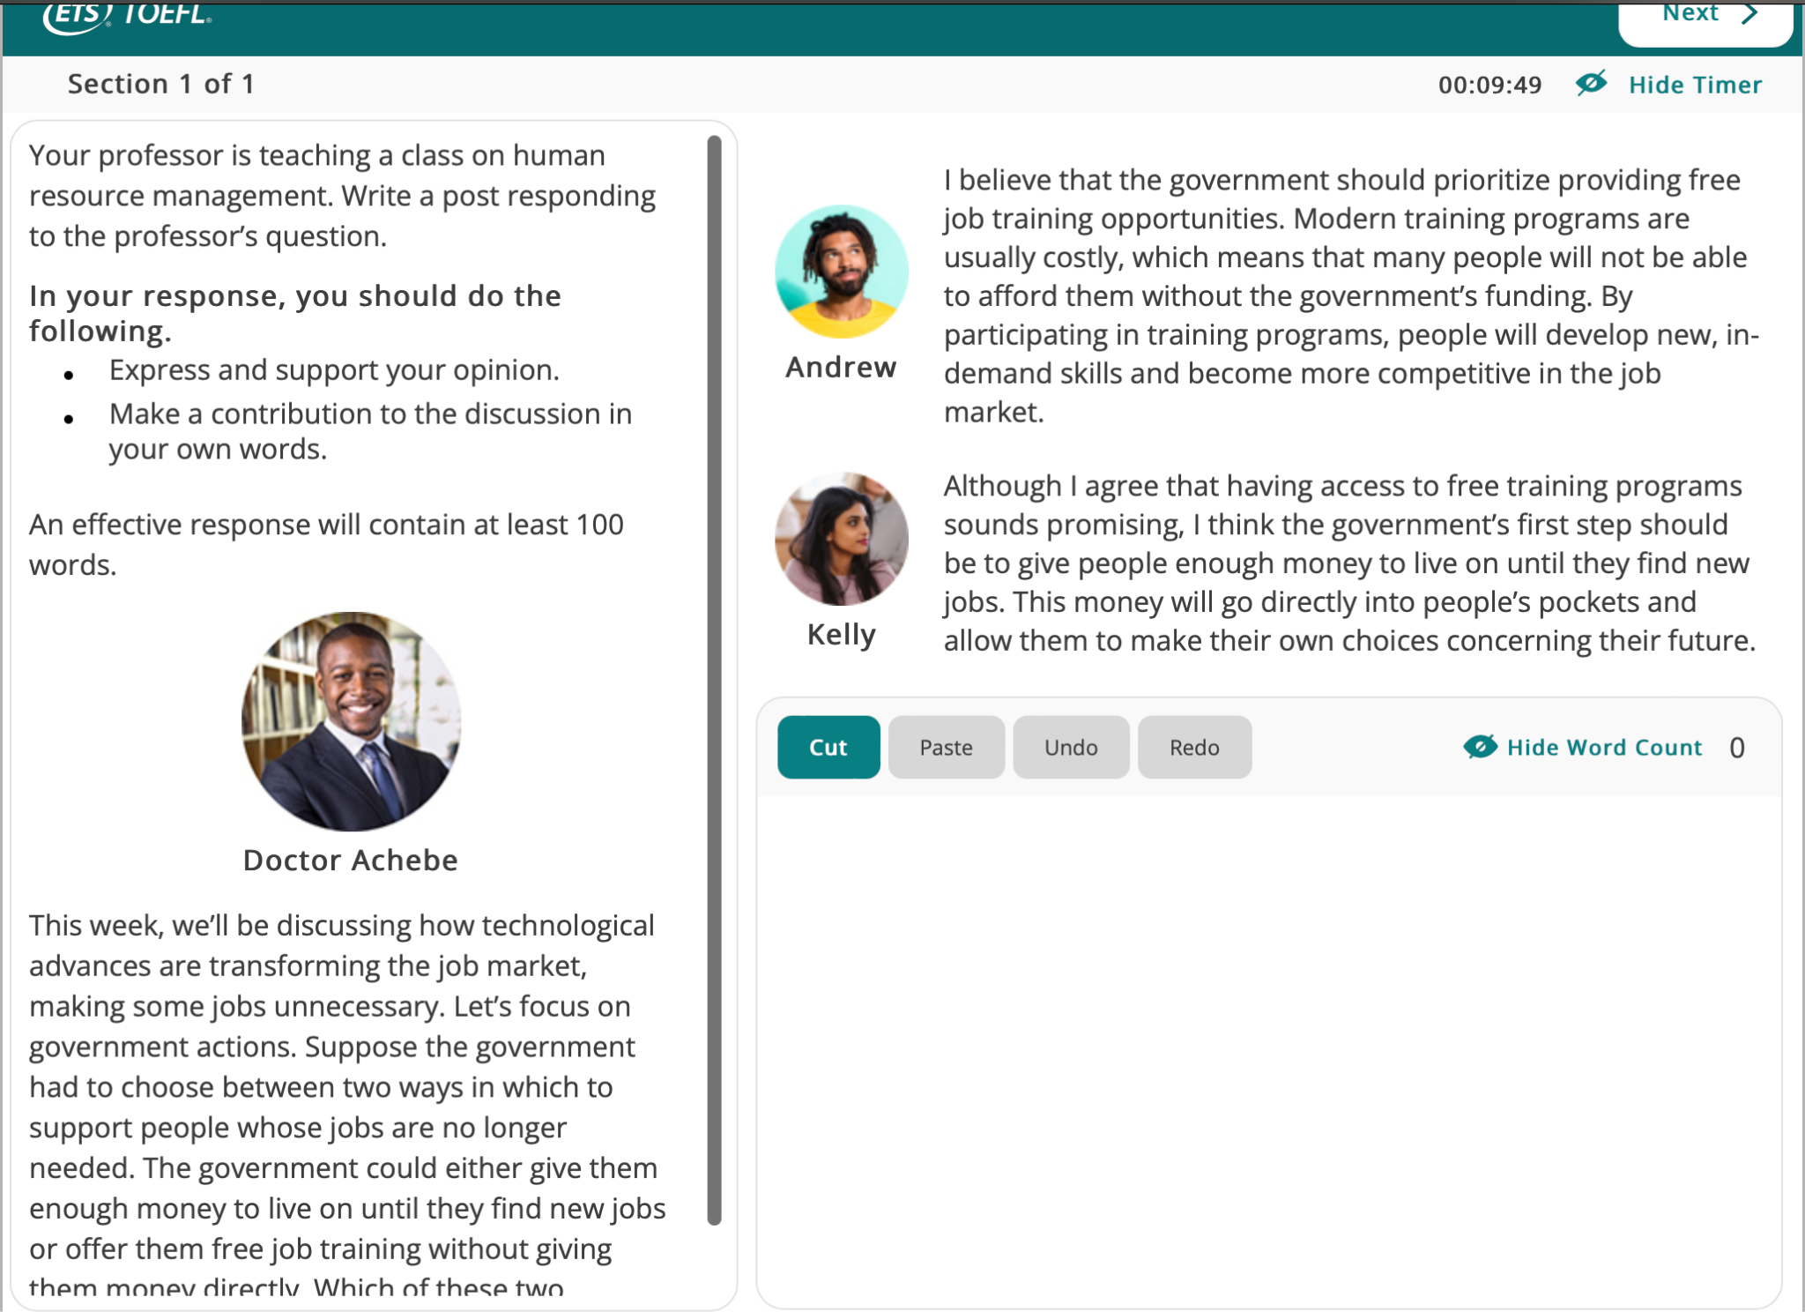

Slide 11
Employment experience

Slide 12
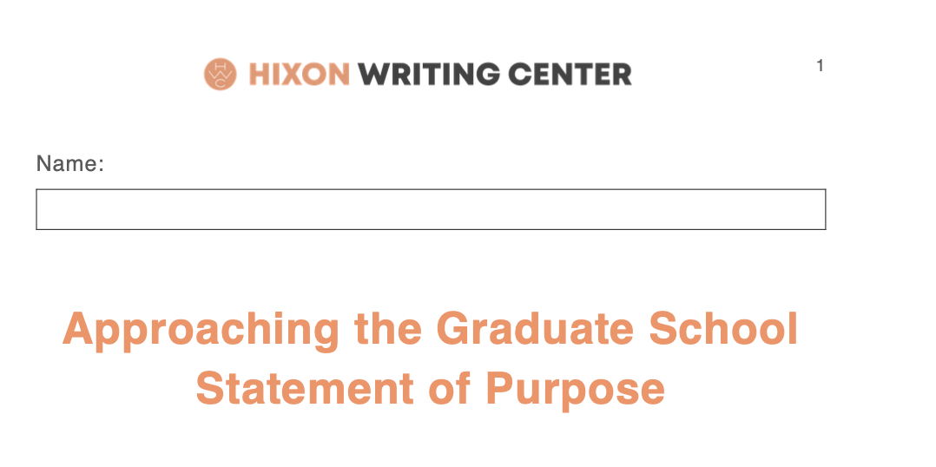
Statement of purpose writing

Slide 15
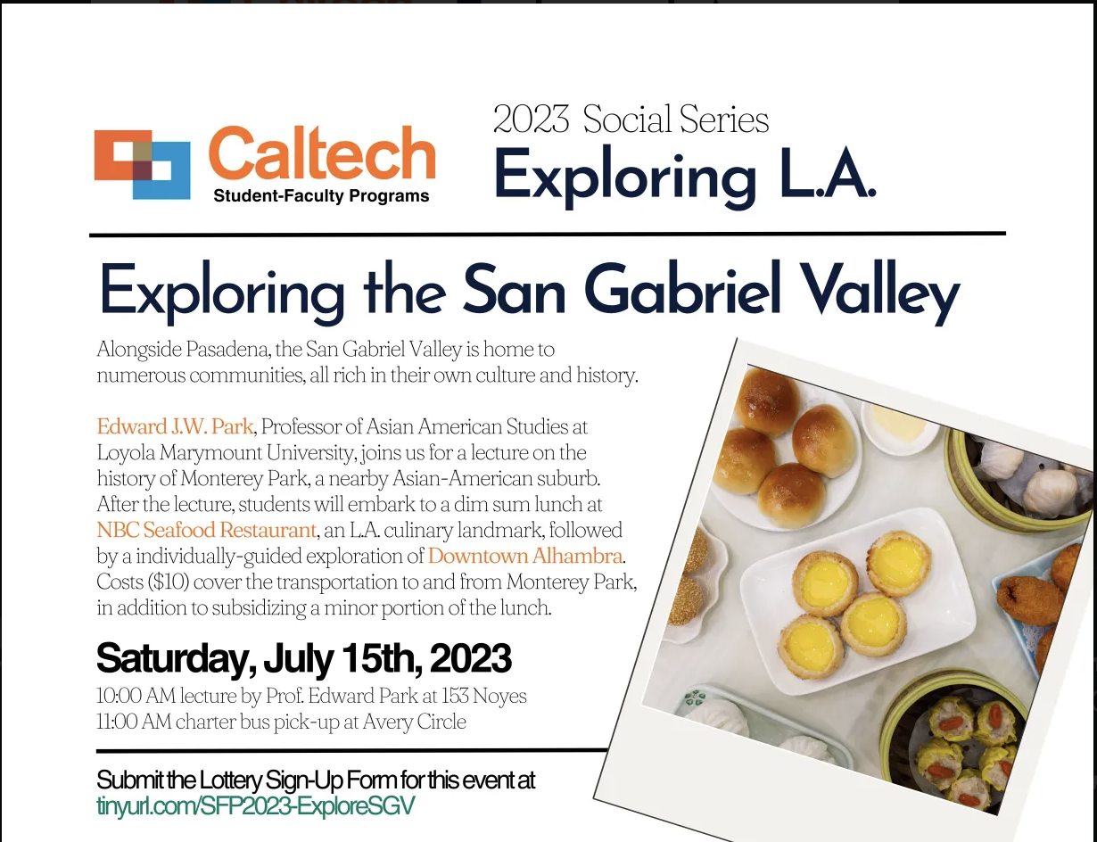
Exploring L.A.

Slide 17
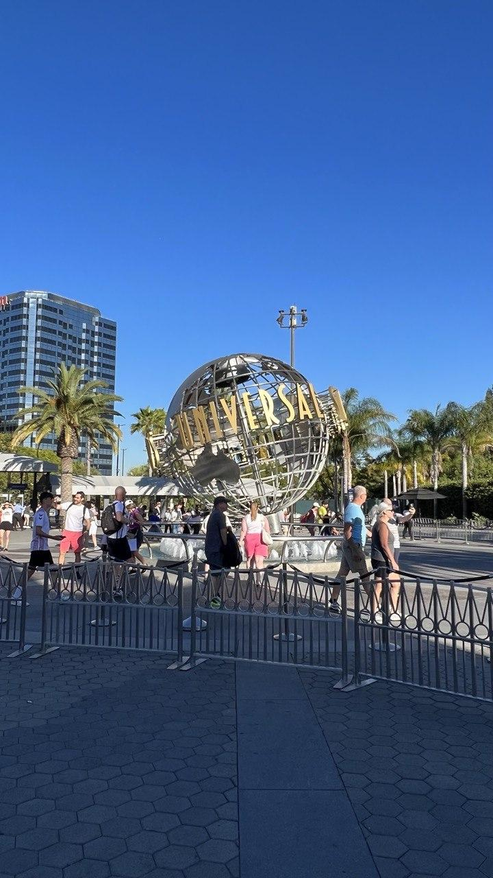
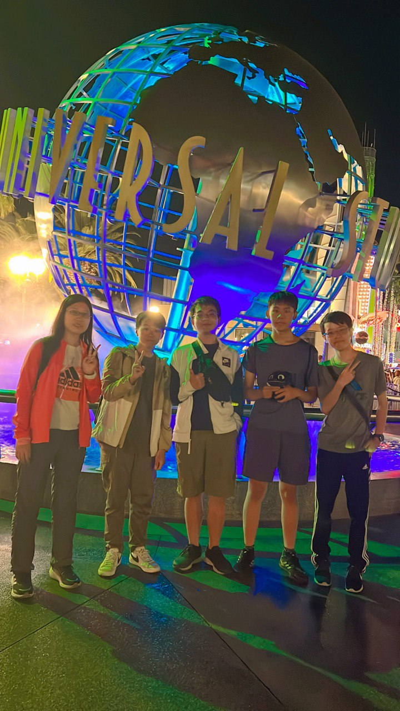

Slide 18
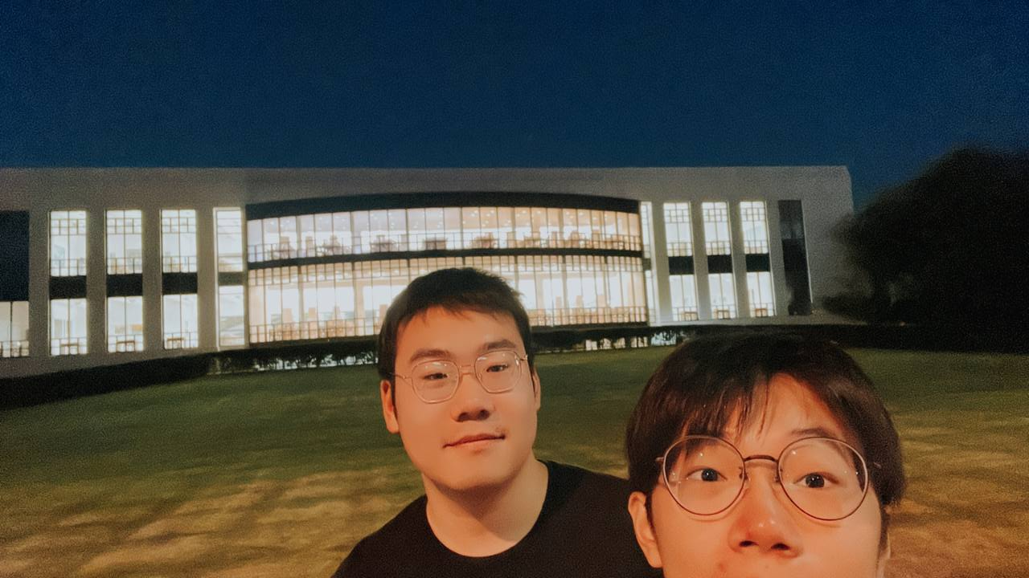
International friends

Slide 19
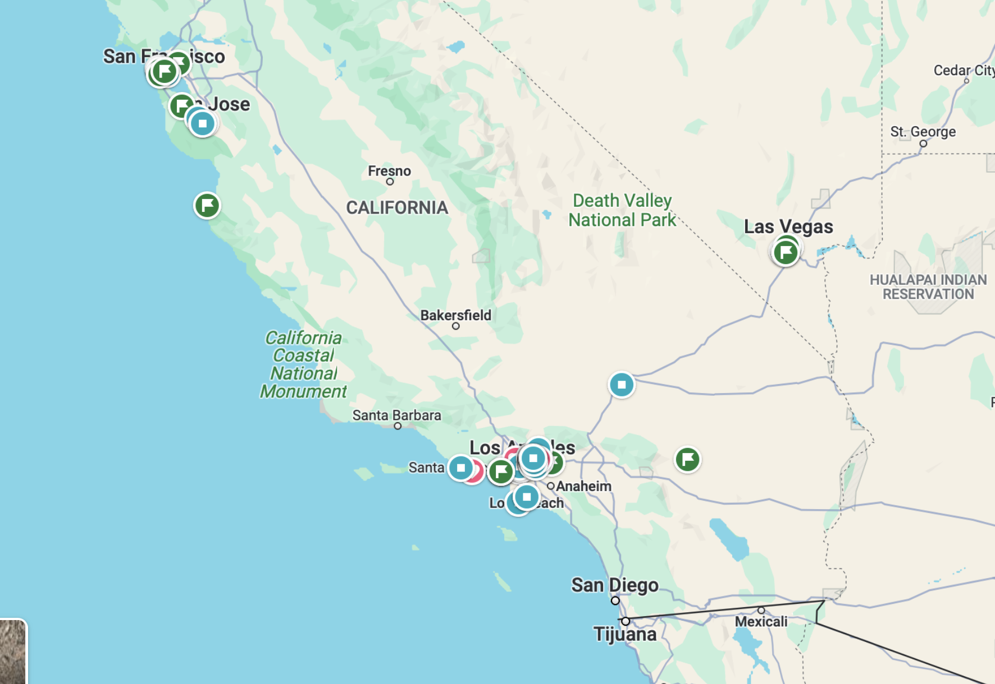
University tour
UCB, Stanford
Caltech, UCLA, USC, UCI, UCSB
UCSD

Slide 20
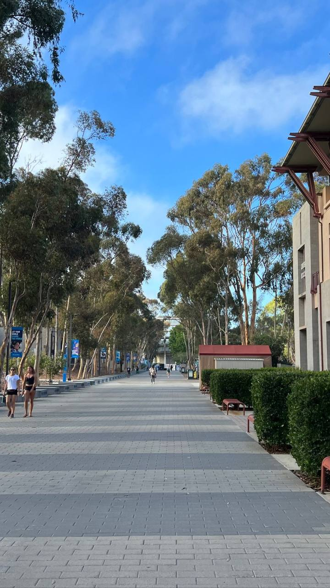
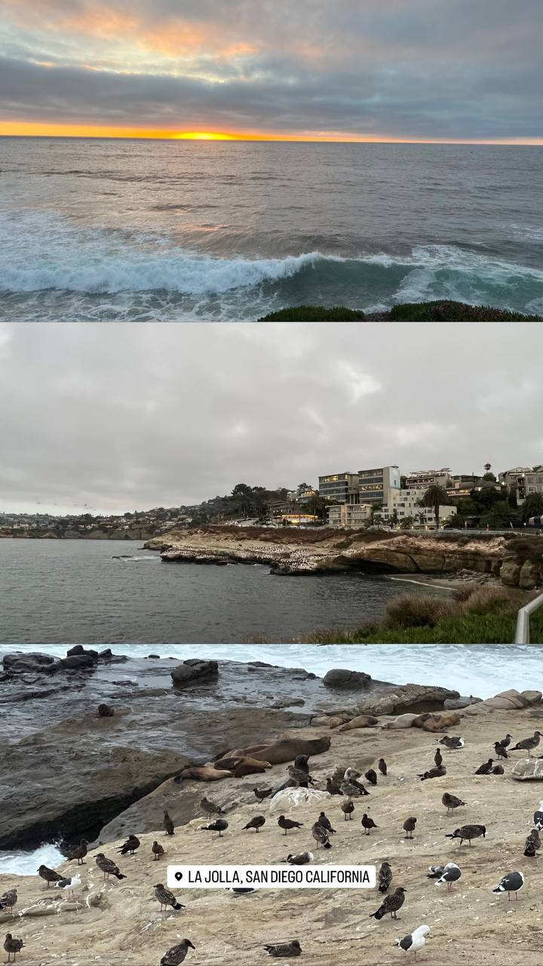
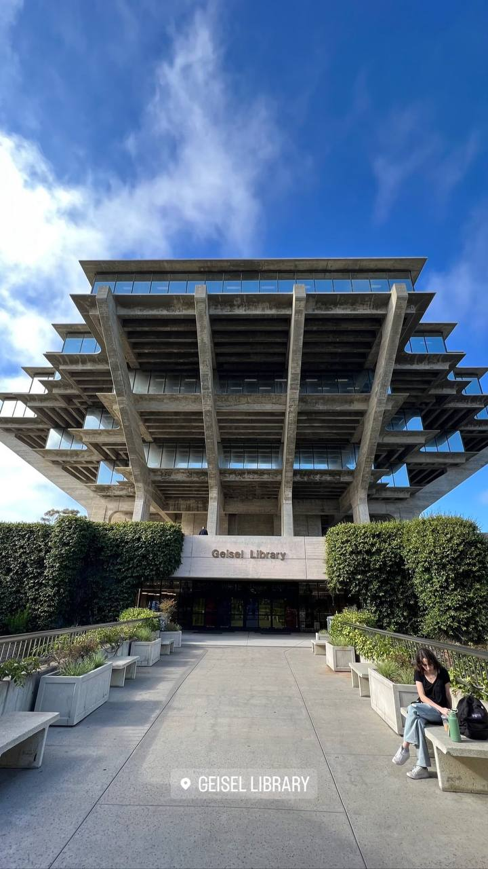

Slide 22
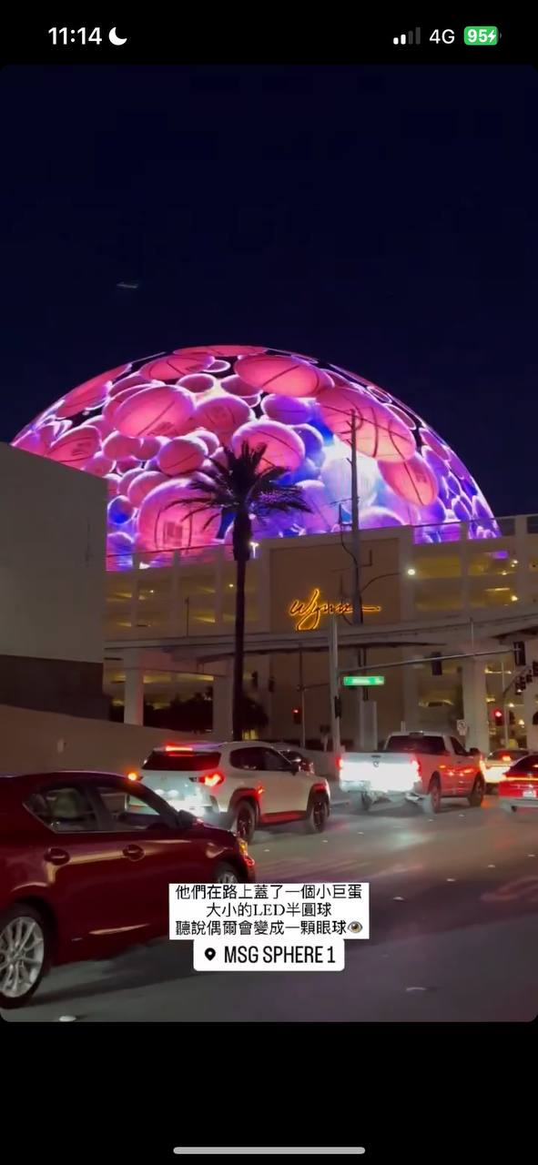
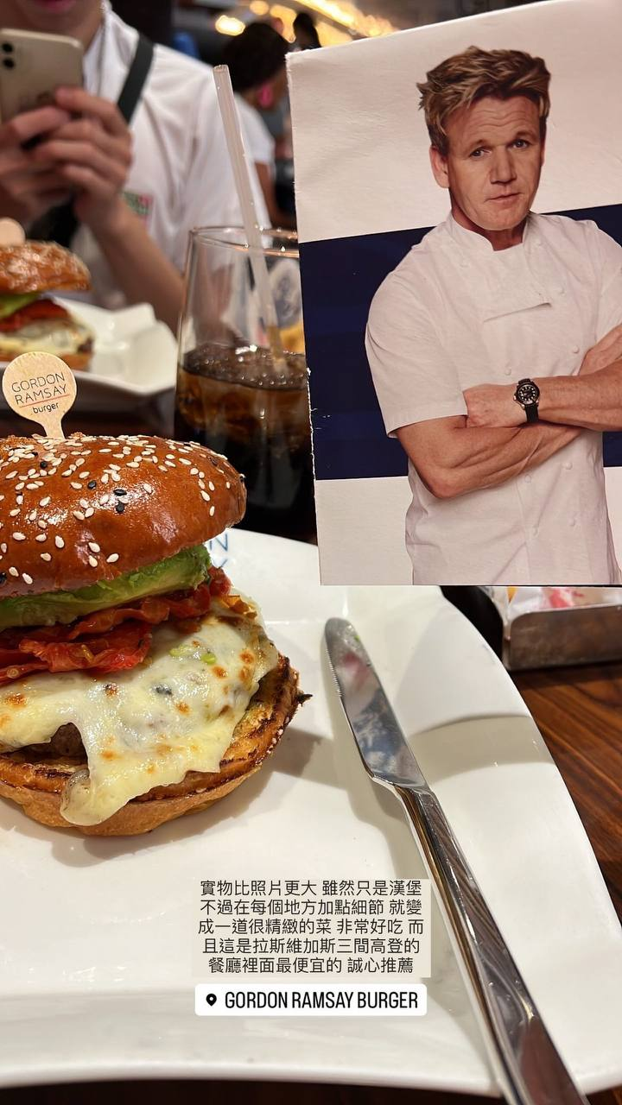

Slide 23
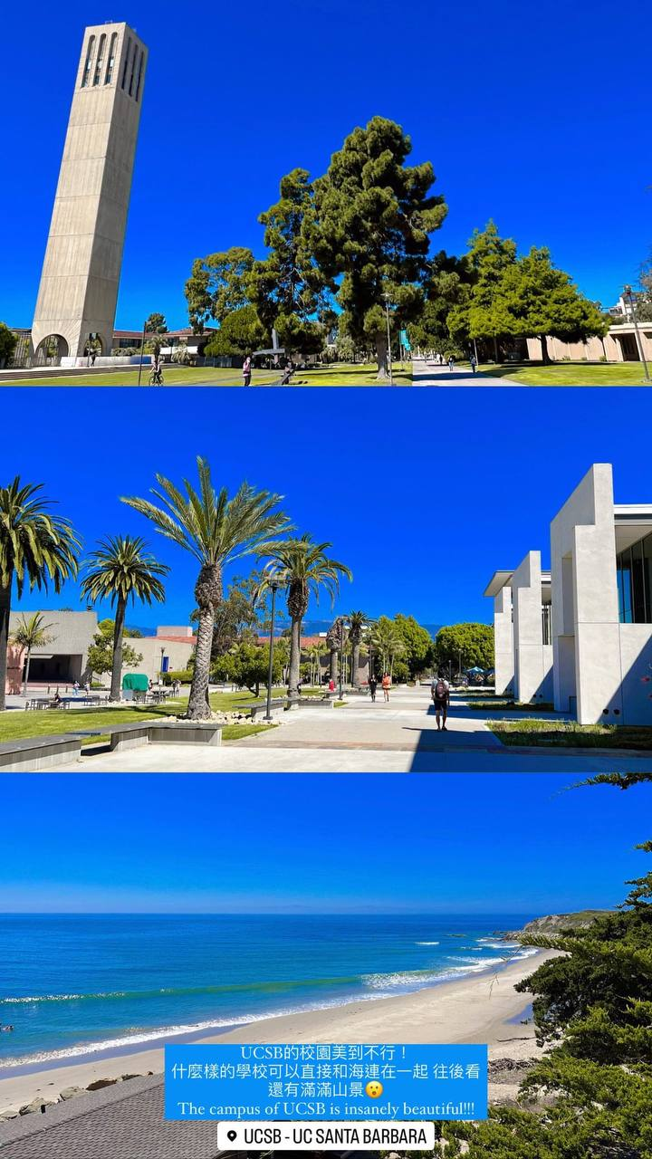
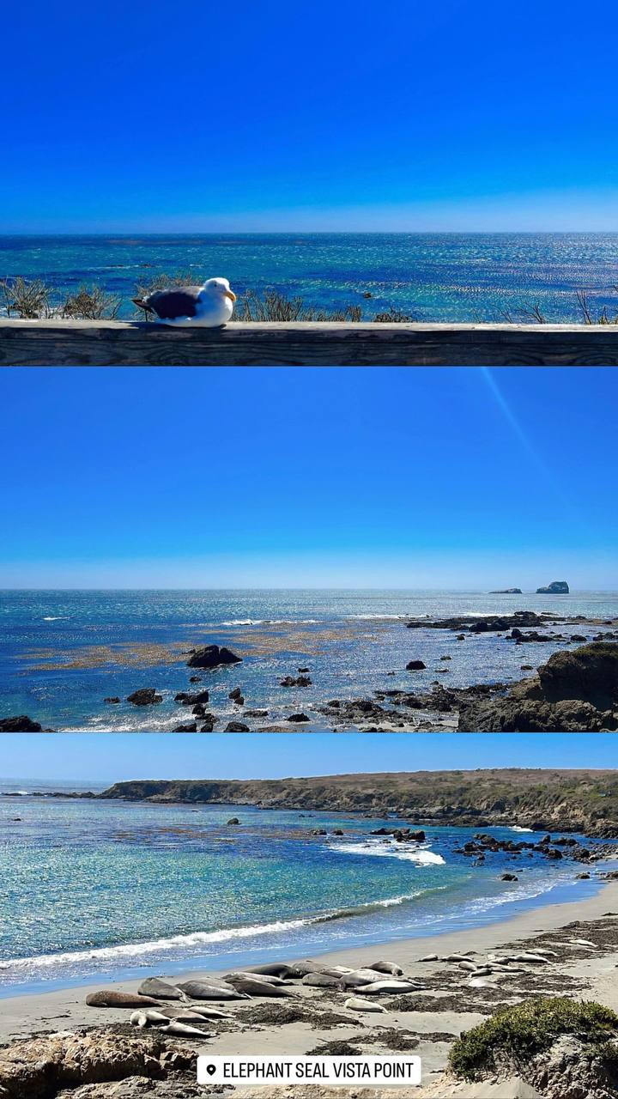
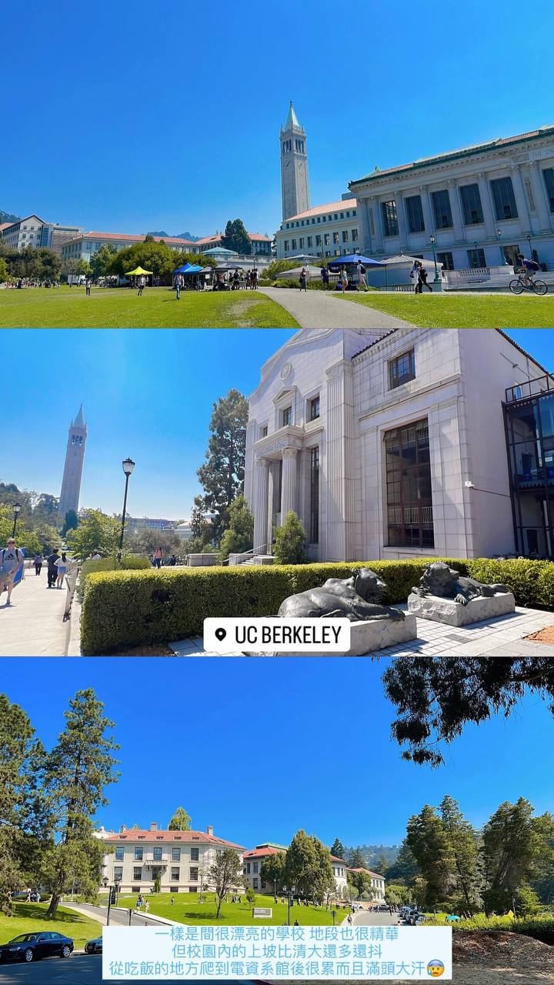

Slide 24
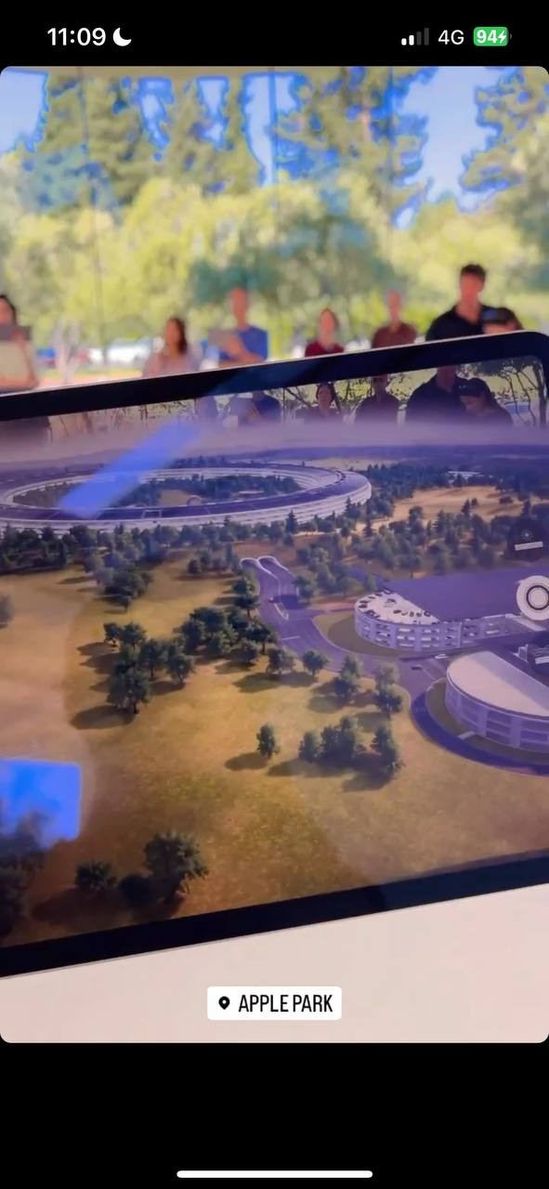
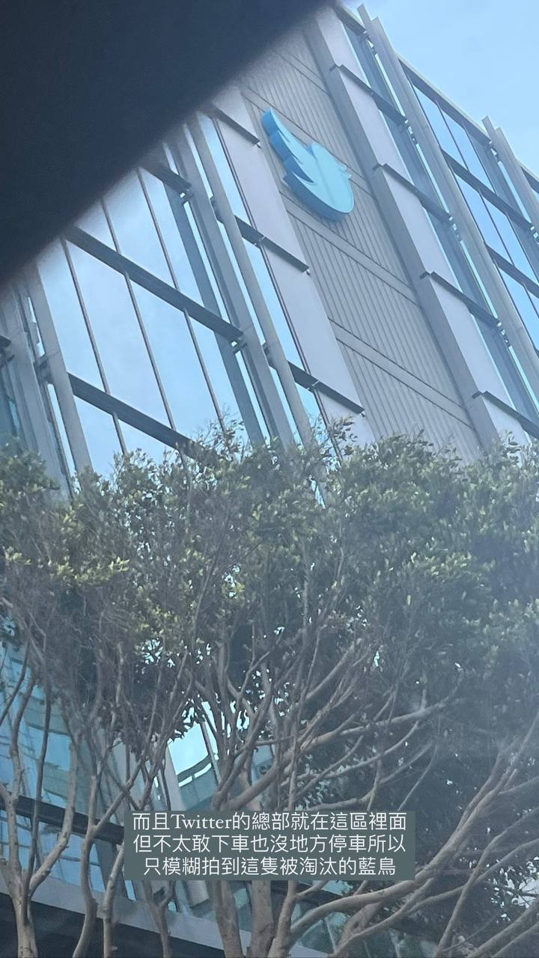

Slide 25
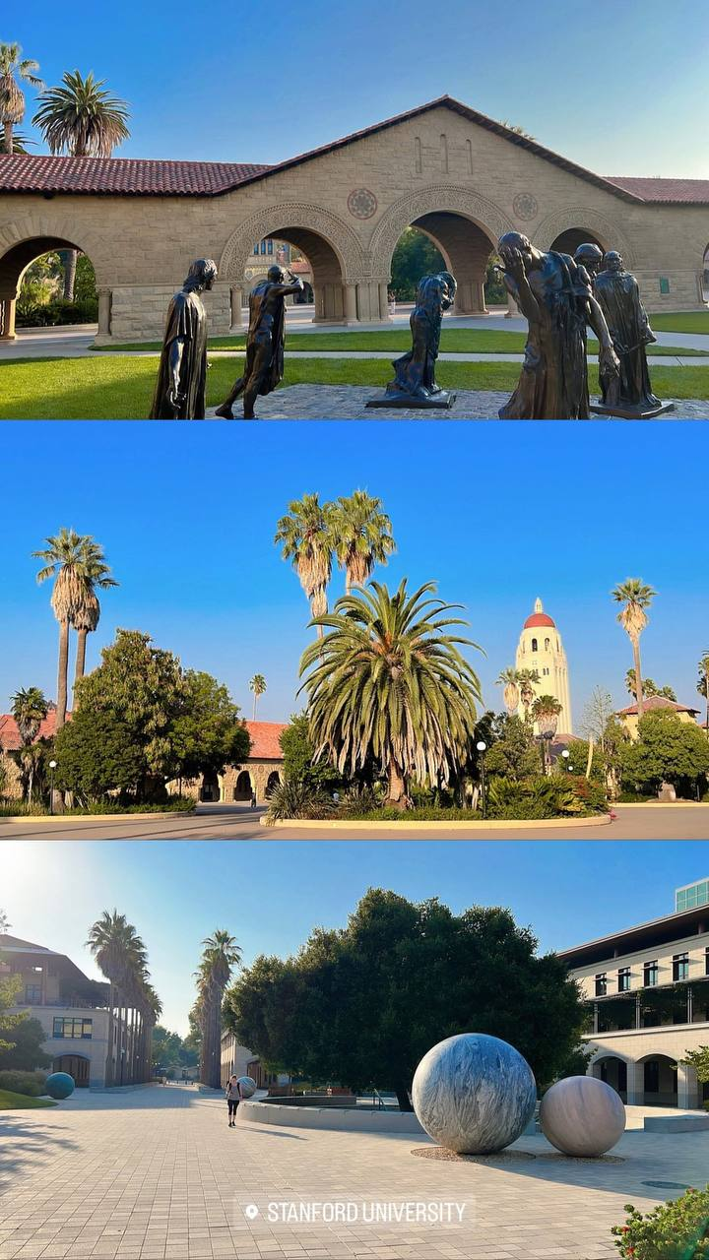
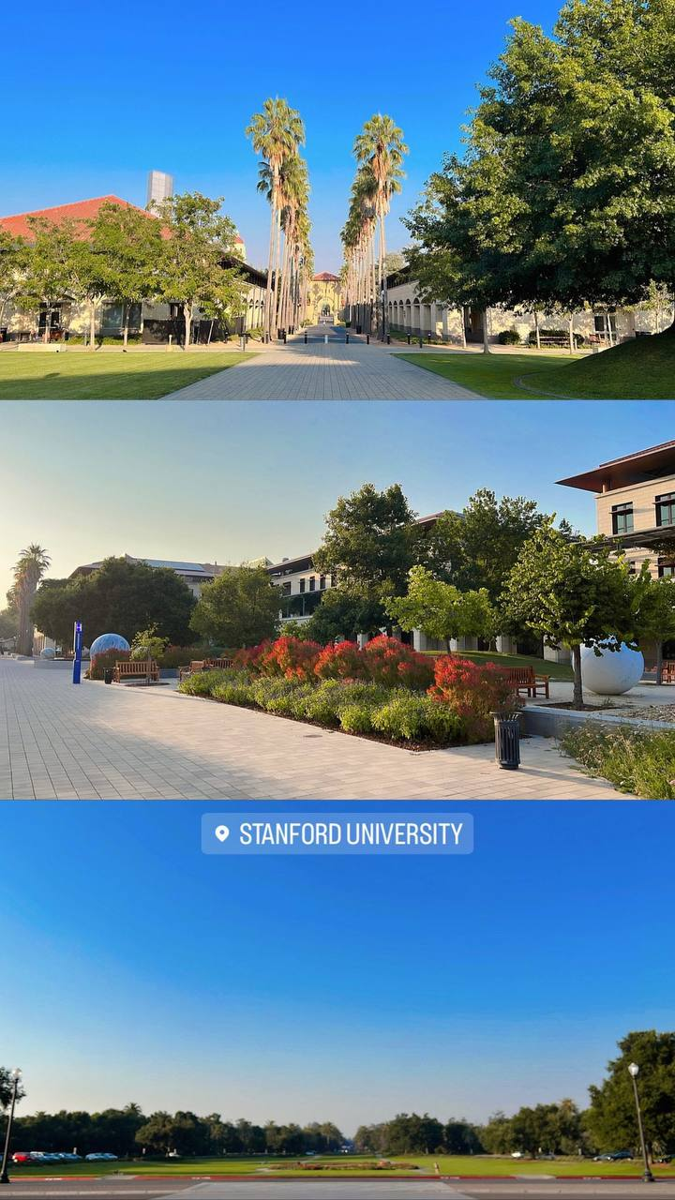

Slide 26
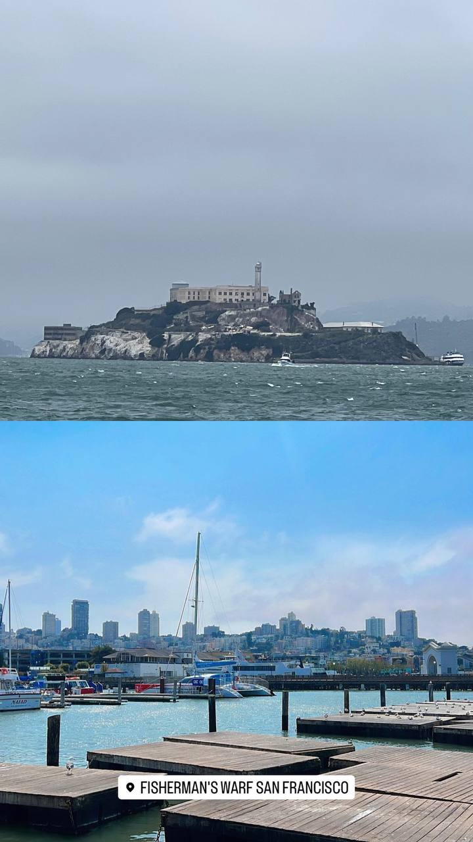
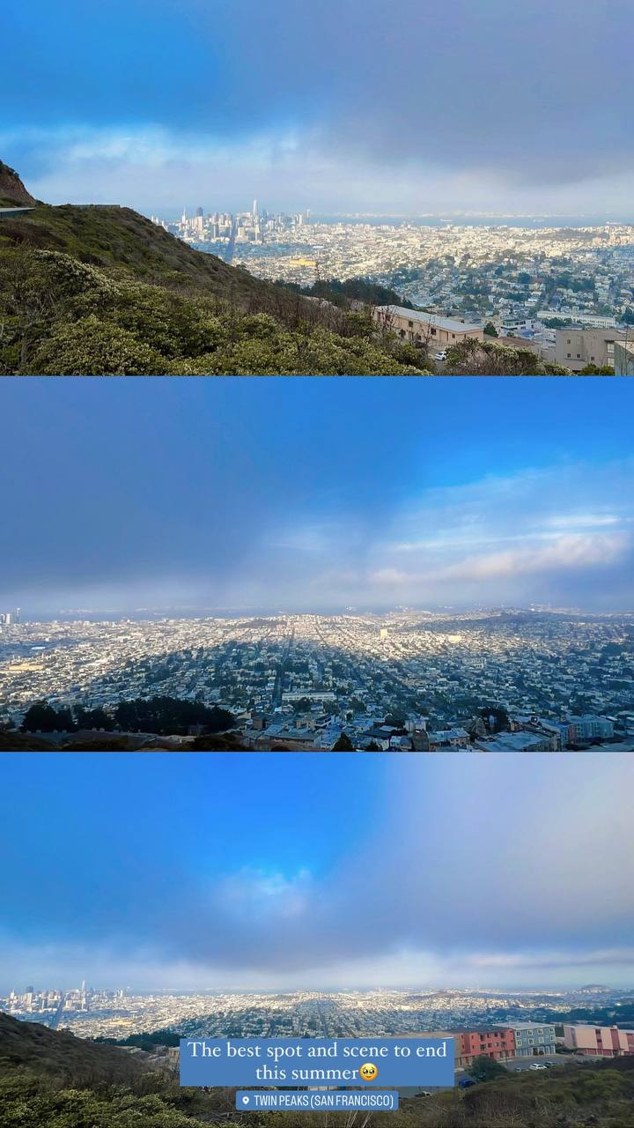

Slide 27
Conclusion
Use the above mentioned tips in your application.
If you still have any questions after searching on the website, send a mail to whoever you think that might help you immediately !!
What can the SURF program provide you with
English improvements
Writing training
L.A. tour
Connection
International friends
Employment experience

Slide 28
2024 Caltech SURF program

Slide 29
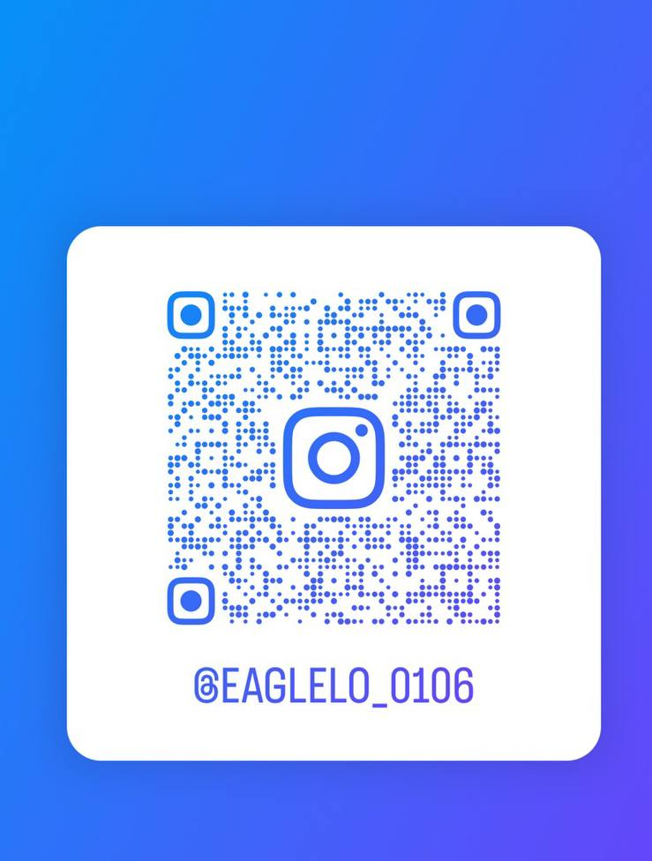
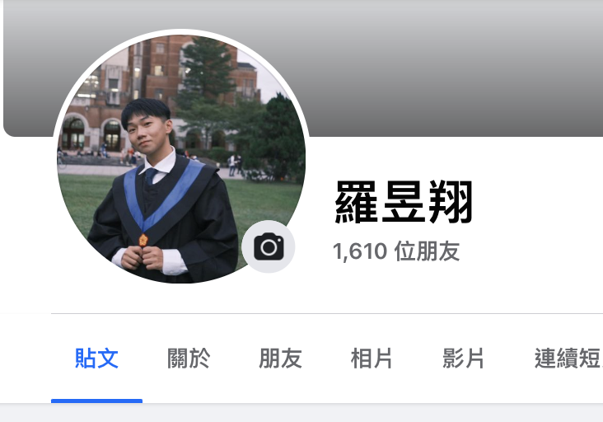
How to contact me

Slide 30
Thanks for listening

